Slide 1


Customer Churn Analysis
Boutique sales products Analysis
Group 3$
Prepared by: Chasnick Désir
Ketenie Flore Thénéus
Fritz Gerald Junior Valcin

Slide 2

Introduction
We are facing a leading company in the telecommunication market: "TELCO" which for years has not been able to find growth niches. TELCO is currently facing a massive disintegration of its customer base, which is turning more and more to other competitors.
TELCO asked us to help them with these tasks:
1. help them identify the types of customers who churn
2. predict who of their current customers will churn next month.

Slide 3
Problem
The leading company Telecom has a massive market share but is facing a major problem: "Its customers are increasingly turning to its competitors".
The different stakeholders impacted by the problem are:
the marketing team, the customer service team and the customers.
This problem is very important for the company because a company that loses customers can find itself deprived of its source of income and go bankrupt, this will have a direct impact on the profitability of the company given the complexity and severity of the threats it faces when it fails to retain its customers while offering them a better service

Slide 4
Methodology
To realized this project, we used:
A file of 7000 customers
Data processing using Python 3
- Cleaning Data with pandas
- Data transformation with Pandas/numpy
- Statistics visualization with
seaborn/matplotlib and scipy.stats
Results (Summary Statistics)
Slideshow made by Microsoft powerpoint

Slide 5
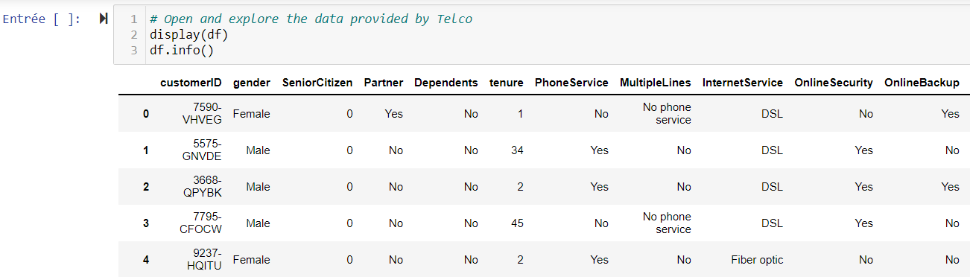
Let’s get a look at the dataset head.

Slide 6
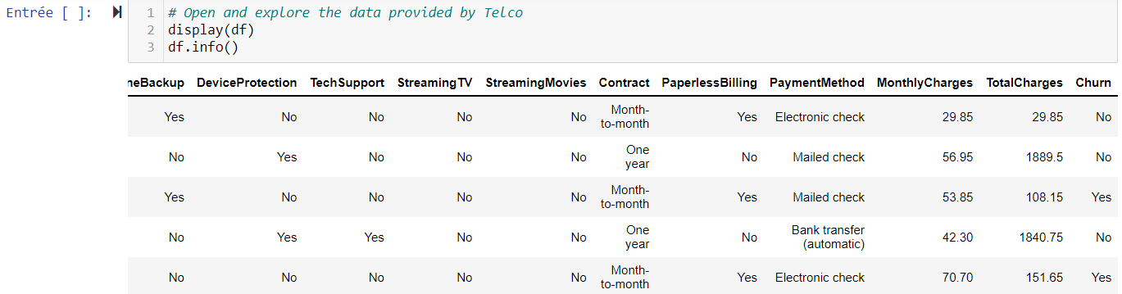
Let’s get a look at the dataset head.

Slide 7
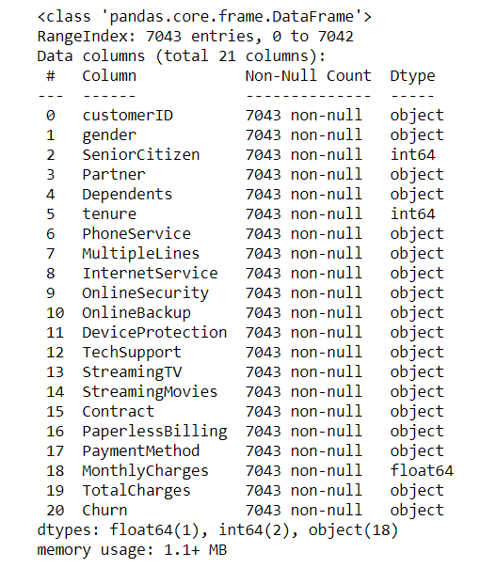
Informations about the dataset
In this dataset, we will have to work with 7043 observations , mostly informations about our customers including payment information, services contract, demographic information, churn status.
The customers type is particular senior citizen.

Slide 8
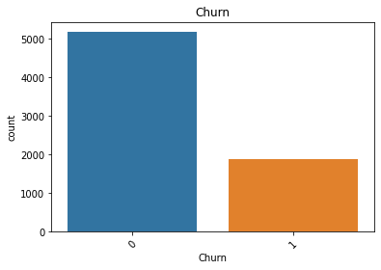
Summary of the customer churn
This graph display the number of churn customer that were found.
There was about 1869 Churned customer during the last months. It represents 26.53% of the customers dataset. A rate of 62 customers per day.

Slide 9
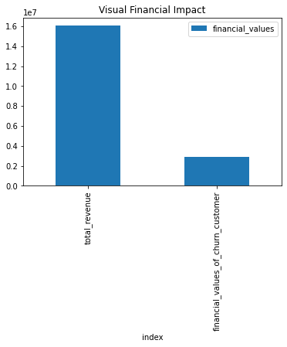
Financial visualization of the impact of contract terminations.
This graph helps us to visualize the financial Churn impact. Telco loses approximately $2,862,926 per month on a total of $16,056,168. That is a ration of 17.8% of its income.

Slide 10
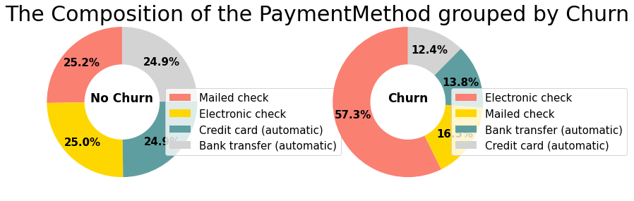
Summary of Churn Payment Method
This graph shows us that among the No Churn 24.9% have a payment method by Bank transfer, 24.9% have a payment method by Credit card(automatic), 25.0% have a payment method by Electronic check and 25.2% have a payment method by Mailed check
Among the Churn, 12.4% have a payment method by Credit card(automatic), 13.8% have a payment method by Bank transfer(automatic), 16.5% have a payment method by Mailed check and 57.3% have a payment method by Electronic check.

Slide 11
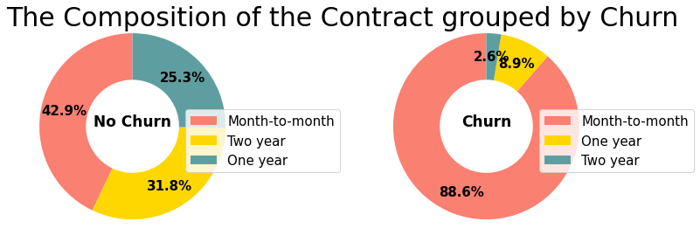
Summary of the Contract Method
This graph shows that among the No Churn 25.3% sign a One year contract, 42.9% sign a Month-to-month contract and 31.8% sign a Two year contract.
And among the Churn 2.6% sign a Two year contract, 88.6% sign a Month-to-month contract and 8.9% sign a One year contract.

Slide 12
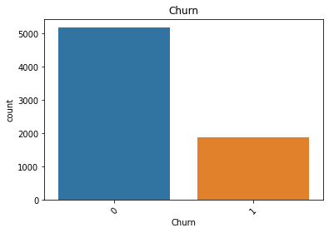
1.How much is churn affecting the business? How big is churn compared to the existing customer base?
Questions
As we have calculated the amount of customers who cancelled their contracts and their percentage values before: we can say that: 1869 customers or 26.54% of Telcom's customer base cancelled their contracts the previous month.
We have calculated above that customer losses cost Telco approximately $2,862,926.9 or 17.83% of their total revenue.

Slide 13
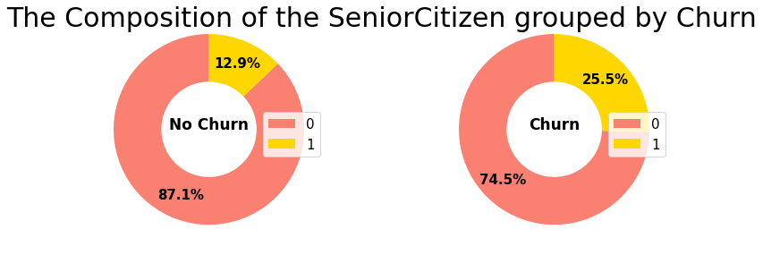
Questions
2.Explain churn by the below categories. Are there any factors that combine to be especially impactful?
a.Customer demographics like age and gender
we have 26% of churn customer who are senior citizens

Slide 14
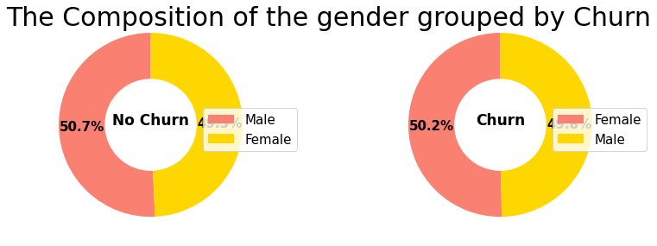
Questions
2.Explain churn by the below categories. Are there any factors that combine to be especially impactful?
a.Customer demographics like gender
we have about 50% of men and 50% of women in churn customer.

Slide 15
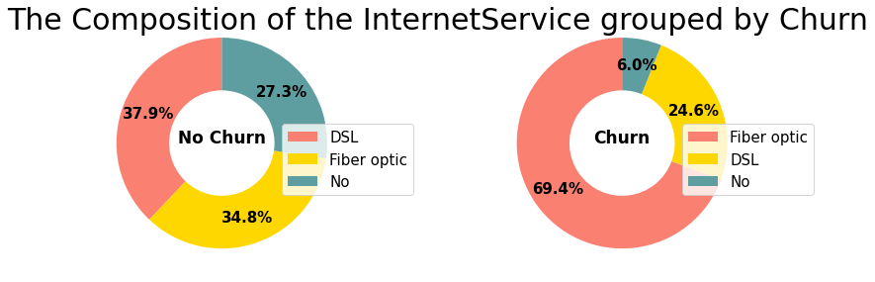
Questions
2.Explain churn by the below categories. Are there any factors that combine to be especially impactful?
b.Services used
-70% use fiber optic internet, and only 6% of them do not sign up for the Internet.
-65-80% do not use additional internet services such as 'OnlineSecurity', 'OnlineBackup', 'DeviceProtection', and 'TechSupport'.
-50% don’t use Streaming movies/ Streaming TV and 40% do.

Slide 16
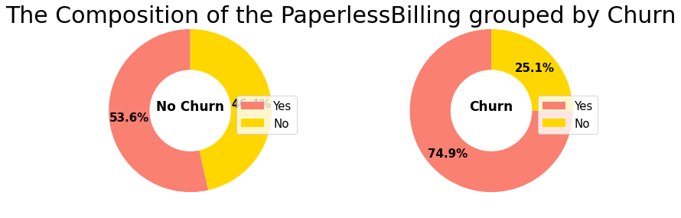
Questions
2.Explain churn by the below categories. Are there any factors that combine to be especially impactful?
c.Billing information
-43% of customers sign a Month-to-month contract/ 32% sign a Two year contract/ 25% sign a One year contract.
-74% adopt paperless billing.

Slide 17
Questions
3-What services are typically purchased by customers who churned? Are any services especially helpful in retaining customers?
-43% of customers sign a Month-to-month contract. 32% sign a Two year contract/ 25% sign a One year contract.
-74% adopt paperless billing.

Slide 18
Questions
4.How long will it take for the company to lose all its customers? Which demographics will they lose first?
Telco will lose all of its 7043 clients in around 4 months with the lost of 62.3 customers per day.
Which demographics will they lose first?
Based on our correlation graph previously made, we could identify that the groups with the following characteristics:
-They are not dependent.
-They don't have partners.
-Senior citizen.

Slide 19
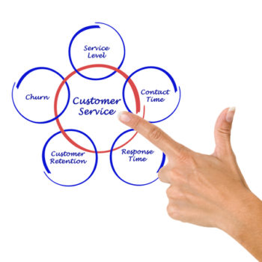
Discussion
Aligning all that with the above analysis, we can draw some conclusion here for all 2 groups:
THE LEAVING CUSTOMERS
26.6% of customers in this sample left within the last month. Most of them have no partners or dependents. They usually use fiber optic internet, and they don’t sign up for additional services other than Streaming movies/Streaming TV.
Most of them sign a Month-to-month contract, and leave as soon as the contract expires. Paperless billing and electronic payment are supported by them, and their bills are usually higher than other customers.

Slide 20
Discussion
THE STAYING CUSTOMERS
73.4% of the clients in this sample have stayed for the past month.
Most of them do not spend much, monthly fees are concentrated at $20. (Range: $18-120).
Most of them use DSL Internet (38%). 66% have no dependents. 53% Do not have a partner.

Slide 21
Proposal Solution 1
1- Better understand customers by establishing a very detailed profile of each of them, anticipate the evolution of their needs and thus adapt its loyalty policy.
2-discover profitable niches requiring a specific marketing treatment.
3- Optimize the adequacy of its offer to each profile: adapt its commercial policy and its pricing to the different customer profiles, adapt its distribution channels and its communication to the different profiles, optimize the impact and the profitability of the commercial offers.
4-Predict which product will be bought by the client.

Slide 22
Proposal solution 1
strengths | Weaknesses
Prevent early contract termination. Discover the potential market. increase sale. | The predictions will not be 100% accurate. Our solutions will not be implemented in less than a month

Slide 23
Proposal Solution 2
For customers with high monthly fees, the company should try to provide additional services or attractive annual and semi-annual offers to reduce the churn rate.
Strength of the solution
This will decrease the intensity of the rivalry between the competitors.
This will increase the bargaining power of customers.
Much higher demand for service
Weaknesses of the solution
Risk of lower profits for the company.
Risk of increased operating costs for TELCO. Costs that we cannot yet evaluate due to lack of internal information.

Slide 24
5 -Recommandation
How to face them?
Short term: Reward customers for their loyalty and mitigate their dissatisfaction through the use of an automated gift.
Pricing strategies could also be used, for example, once customers have made more than 4 customer service calls during the term of their contract, a discount could be offered on their next bill to dissipate customer dissatisfaction and show empathy and recognition of the customer experience.
A personalized and friendly email could also be sent to the customer, acknowledging the issues the customer had by notifying them of a reward and/or discount on the next bill.
For this we need to conduct a satisfaction survey.
Build a machine learning model.
This last part, machine learning will be further developed in deliverable part 2.

Slide 25
References & Appendices
1- https://www.kaggle.com/blastchar/telco-customer-churn/data
2-https://courses.ayitianalytics.org/courses/take/business-analysis/pdfs/26869168-customer-churn-analysis
3-https://courses.cognitiveclass.ai/courses/course-v1:CognitiveClass+ML0101ENv3+2018/course/
4-https://courses.cognitiveclass.ai/courses/course-v1:CognitiveClass+DA0101EN+2017/course/
5-https://github.com/ChasnickDesir1995/Churn-Customer-Analysis.git

Slide 26
THANKS
For more information about the project click on this link:
https://github.com/ChasnickDesir1995/Churn-Customer-Analysis.git

